Slide 1



Preparing Workforce in Facing The 4th Industrial Revolution as An Optimization
of Demographic Dividend
Presented by:
ILY 3000
http://www.free-powerpoint-templates-design.com

Slide 2
1
BACKGROUND

Slide 3
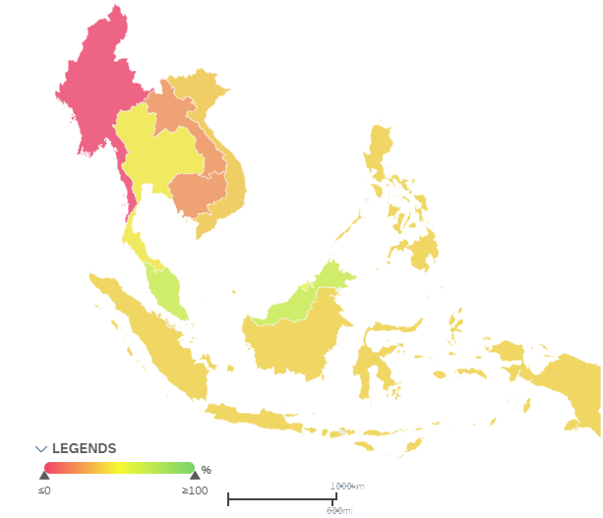
1
BACKGROUND
Networked Readiness Index (NRI)

Slide 4
1
BACKGROUND

Slide 5
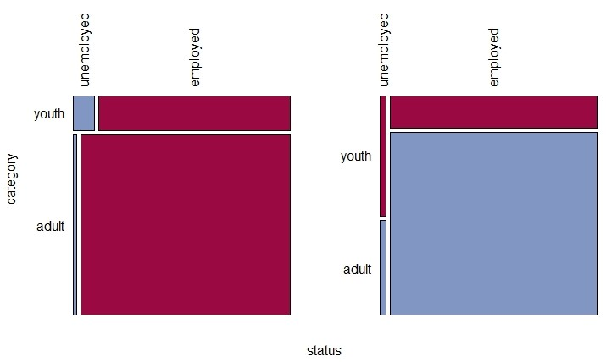
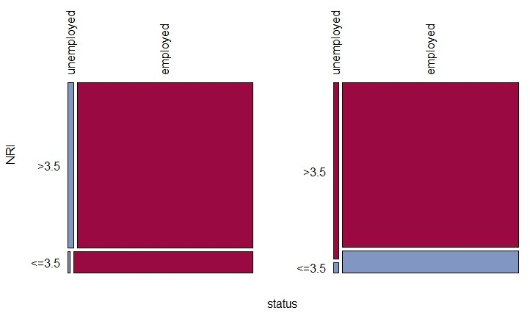
2
FINDINGS
Odds Ratios
7.36
8
2.28
3.27

Slide 6










3
CLUSTER ANALYSIS
Cluster Members
Cluster 1
Cluster 2
Cluster 3
KHM
LAO
BRN
IDN
THA
SGP
MMR
PHL
VNM
MYS

Slide 7
3
CLUSTER ANALYSIS
Cluster Profile
Cluster 1
Cluster 2
Cluster 3
Dependency Ratio
54.59%
Dependency Ratio
42.87%
Dependency Ratio
39.51%
NRI
3.38
NRI
4.26
NRI
6.00
Unemployment
1.43%
Unemployment
3.89%
Unemployment
3.77%
Low unemployment rate
Low age dependency ratio
Low age dependency ratio
Higher age dependency ratio
Moderate NRI
High NRI
Lower NRI
Higher unemployment rate
Higher unemployment rate

Slide 8
4
RECOMMENDATION
Cluster 1
Enhancing infrastructure and education
Average Infrastructure index : 3 and Average Skills index : 4
Cluster 2
Infrastructure and education is already good yet still need improvement
Average Infrastructure index : 3.8 Average Skills index : 5.2 Mismatch between labor demand and supply (e.g. : n 2018, science degrees are in great demand in Thailand, but 70% of new graduates hold social science degrees)
Cluster 3
Keep up-skilling its workforce regarding the rapid change of technologies.
Robot workers density : 658 per 10000 employees

Slide 9
4
RECOMMENDATION
For
ASEAN
Countries Overall
Develop youth through education and digital literacy
Shift from long-term blueprints to rolling three-year plans
Connecting the unconnected
Create education networks

Slide 10
References
(2019, August 2). Retrieved from Citi GPS Technology Work: https://www.oxfordmartin.ox.ac.uk/downloads/reports/Citi_GPS_Technology_Work.pdf
Asian Development Bank. (2019, August 2). Retrieved from ASEAN 4.0: What Does The Fourth Industrial Revolution Mean For Regional Economic Integration: https://www.adb.org/sites/default/files/publication/379401/asean-fourth-industrialrevolution-rci.pdf
Breene, K. (2019, August 2). World Economic Forum. Retrieved from Why networked readiness index does matter?: https://www.weforum.org/agenda/2016/07/what-is-networked-readiness-andwhy-does-it-matter/
Deloitte. (2019, August 2). Retrieved from Fourth industrial revolution is here - are you ready?: https://www2.deloitte.com/content/dam/Deloitte/za/Documents/Consumer_Industrial_Products/za_Global_Industry4-0_Are-you-ready_Report_ZAFinal.pdf
Deloitte. (2019, August 2). Retrieved from Preparing Tomorrow's Workforce for 4IR: https://www2.deloitte.com/content/dam/Deloitte/global/Documents/About-Deloitte/gx-preparing-tomorrow-workforce-for-4IR.pdf
Iskyan, K. (2019, August 2). Stansberry Pacific. Retrieved from This "dividend" will drive growth in ASEAN for years to come: https://stansberrypacific.com/education/investment-education/dividend-will-drive-growth-asean-years-come/
UNFPA. (2019, August 2). Retrieved from First ASEAN Youth Development Index 2016: https://asean.org/storage/2017/10/ASEAN-UNFPA_report_web-final-05sep.pdf
United Nations. (2019, August 2). Retrieved from Median Age: https://population.un.org/wpp/Download/Standard/Population/
World Bank Data. (2019, August 2). Retrieved from Female Population: https://data.worldbank.org/indicator/SP.POP.TOTL.FE.IN?locations=ID-MY-THSG-VN-PH-LA-KH-BN-MM
World Bank Data. (2019, August 2). Retrieved from Age Dependency Ratio: https://data.worldbank.org/indicator/SP.POP.DPND?locations=ID-MY-TH-SG-VNPH-LA-KH-BN-MM-1W
World Bank Data. (2019, August 2). Retrieved from Female Population Ages 15-19 (% of Total Female Population): https://data.worldbank.org/indicator/SP.POP.1519.FE.5Y?end=2018&locations=IDMY-KH-BN-LA-MM-PH-SG-TH-VN&start=2016
World Bank Data. (2019, August 2). Retrieved from Female Population Ages 20-24 (% of Total Female Population): https://data.worldbank.org/indicator/SP.POP.2024.FE.5Y?end=2018&locations=IDMY-KH-BN-LA-MM-PH-SG-TH-VN&start=2016
World Bank Data. (2019, August 2). Retrieved from Labor Force Total: https://data.worldbank.org/indicator/SL.TLF.TOTL.IN?locations=ID-MY-TH-SG-VNPH-LA-KH-BN-MM
World Bank Data. (2019, August 2). Retrieved from Labor Force Participation Rate: https://data.worldbank.org/indicator/SL.TLF.ACTI.1524.ZS?locations=ID-MY-THSG-VN-PH-LA-KH-BN-MM
World Bank Data. (2019, August 2). Retrieved from Labor Force Participation Rate Ages 15-24: https://data.worldbank.org/indicator/SL.TLF.ACTI.1524.ZS?locations=ID-MYTH-SG-VN-PH-LA-KH-BN-MM
World Bank Data. (2019, August 2). Retrieved from Male Population: https://data.worldbank.org/indicator/SP.POP.TOTL.MA.IN?end=2018&locations=ID-MY-KH-BN-LA-MM-PH-SG-TH-VN&start=2016
World Bank Data. (2019, August 2). Retrieved from Male Population Ages 15-19 (% of Total Male Population): https://data.worldbank.org/indicator/SP.POP.1519.MA.5Y?end=2018&locations=ID-MY-KH-BN-LA-MM-PH-SG-TH-VN&start=2016
World Bank Data. (2019, August 2). Retrieved from Male Population Ages 20-24 (% of Total Male Population): https://data.worldbank.org/indicator/SP.POP.2024.MA.5Y?end=2018&locations=ID-MY-KH-BN-LA-MM-PH-SG-TH-VN&start=2016
World Bank Data. (2019, August 2). Retrieved from Total Unemployment Rate: https://data.worldbank.org/indicator/SL.UEM.TOTL.ZS?locations=ID-MY-THSG-VN-PH-LA-KH-BN-MM-1W
World Bank Data. (2019, August 2). Retrieved from Total Youth Unemployment Rate: https://data.worldbank.org/indicator/SL.UEM.1524.ZS?locations=ID-MY-TH-SGVN-PH-LA-KH-BN-MM
World Economic Forum. (2019, August 2). Retrieved from The Global Information Technology Report 2016: http://www3.weforum.org/docs/GITR2016/WEF_GITR_Full_Report.pdf

Slide 11
THANK YOU

